Slide 1


Rockbuster Stealth LLC
Business Insights
3.10 SQL Results | Tableau Public

Slide 2
Project Outline
Motivation: extend business model to online streaming services to stay competitive
Objective: Share business insights on customer base and business performance, provide recommendations

Slide 3




Film Inventory
1000 licensed films only available in english
Starring 200 different actors
All movies have a release year of 2006
 | Minimum | Maximum | Average
Rental duration (in days) | 3 | 7 | 5
Rental rate (in $) | 0,99 | 4,99 | 2,98
Length (in min.) | 46 | 185 | 115
Replacement Cost (in $) | 9,99 | 29,99 | 19,98

Slide 4
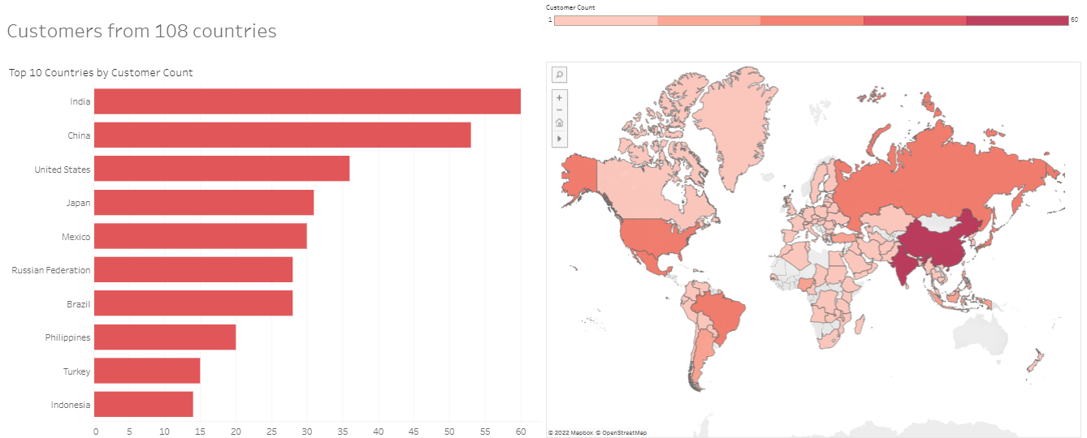
Rockbuster Customer Base

Slide 5
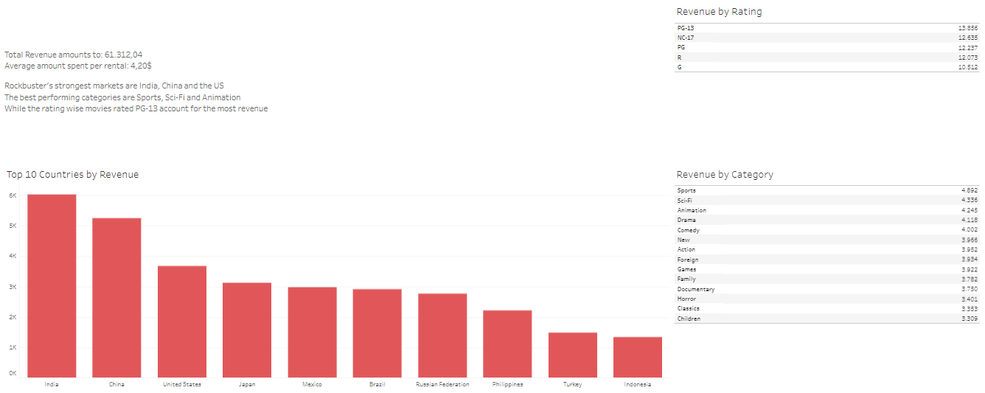
Revenue Analysis

Slide 6
Recommendations
Add languages to attract non english-speaking customers
Expand film inventory to include more current films (not only from 2006)
Push the top 3 markets India, China and US
Look for films in the categories Sports, Sci-Fi and Animation as the Top 3 revenue drivers
Look to add more films rated PG-13

Slide 7
THANK YOU FOR YOUR ATTENTION!

